Slide 1
Nepal travel: Discover Hidden Natural Retreats
Group:5
Presenters
Aashish karki (24080262)
Kismat giri (24080282)
Sugat katuwal (24080304)
Under Supervision of
Mr. Sanju Shrestha

Slide 2
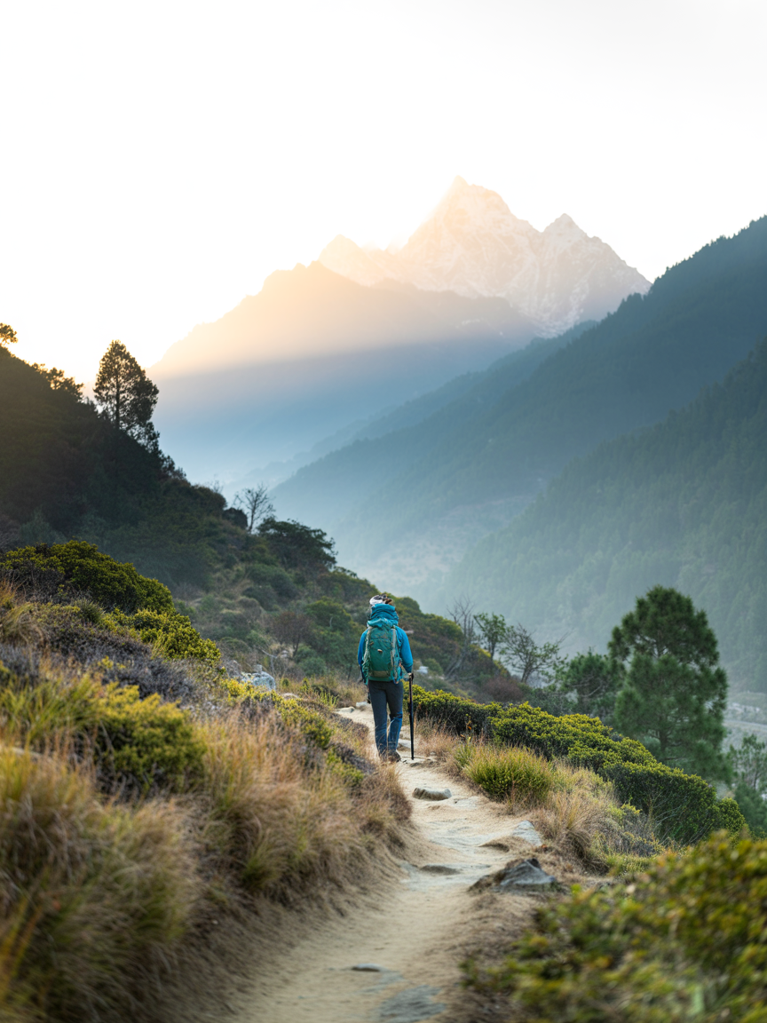
Introduction : What & Who
Nepal Travel: Discover Hidden Natural Retreats
Nepal Travel is a platform designed to help users discover hidden natural places across Nepal. It focuses on lesser-known destinations such as forests, hills, lakes, and peaceful viewpoints. The platform allows travelers and locals to explore, share, and review travel experiences.
Users can access useful information like routes, seasons, photos, and travel tips. The system aims to promote local tourism and make trip planning easier and more reliable.

Slide 3
Project progress
Completed tasks
Frontend Development
Homepage with destination listing and spotlight picks
Login and registration page with clean UI
Destination detail page (name, description, trip info, budget, facilities)
Add destination form with multi-step structure (Basics, Story, Media, Route, Cost, Stay)
Admin dashboard
Search and filter interface
Database & Backend
All core database tables created (Users, Places, Reviews, Collections, Saved Places, Photos, Routes, Categories)
Foreign key relationships defined between tables
User registration and login (Traveler / Admin)
Admin activities ( verify, manage places)
Google map api integration
OTP verification while signing up
User authentication

Slide 4
What was remaining
Map integration
The google map was yet to be implemented to help travellers find their roots easily
User Dashboard
The user dashboard was not fully implemented with all features.
Otp verification
For the security purpose, the otp verification while signing up was remaining to be implemented in our website.
Review and rating system
The feature where all the travellers and users could rate a place and leave a review was still pending.
All the above features, integration and other remaining works were succefully completed

Slide 5
Feedbacks and improvements
Google Maps Integration
The map feature on the destination detail page was not working properly and was advised to make it smooth.
Review System
The reviews from the users were hard to locate. One of our friend advised us to make visible clearly and was fixed.
Save and plan Feature Users weren't sure if their "save" action had actually worked since there was no confirmation. A small visual cue (icon change/toast message) was added to confirm when a place is saved.
Search & Filter Functionality Users found it difficult to filter destinations by category (mountains, lakes, waterfalls, etc.) as the filter options were not clearly labeled. This was fixed by adding clearer category tags and a more intuitive filter bar.

Slide 6
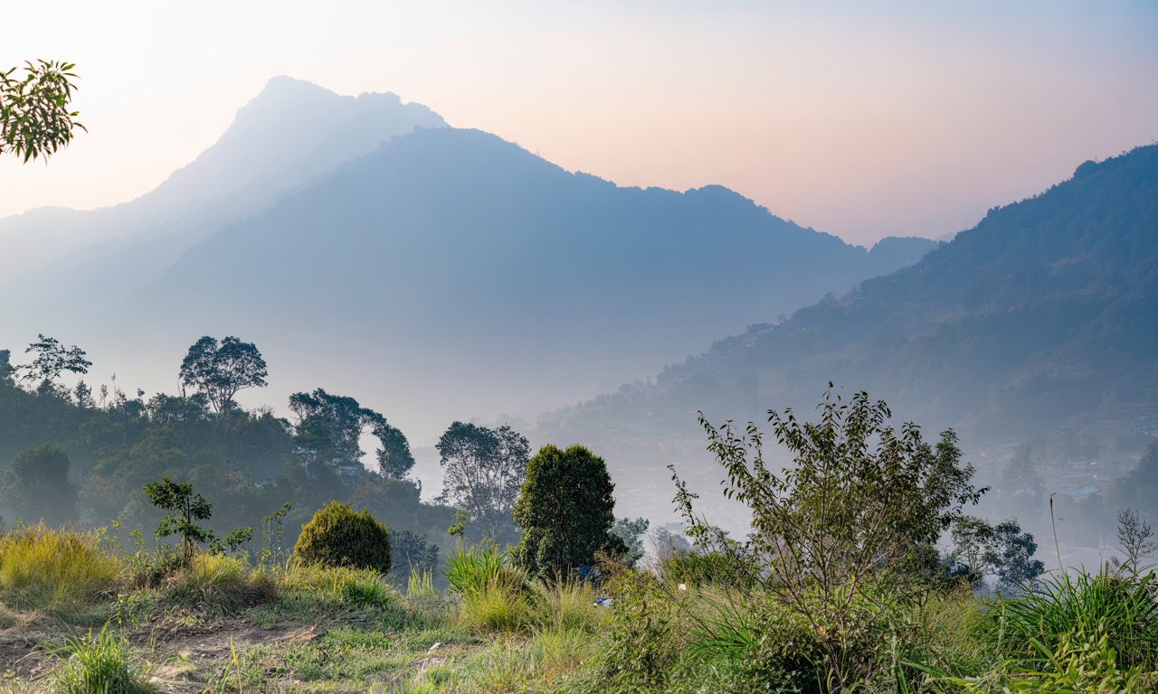
Conclusion
Nepal Travel is more than a trip-planning platform — it is a way to discover hidden gems, share trusted local knowledge, and make every journey more meaningful.
Helps travelers uncover authentic places beyond the usual tourist paths
Empowers local communities by giving them visibility and a stronger voice
Makes trip planning easier with trusted details, routes, and seasonal tips
With Nepal Travel, exploration becomes more connected, more personal, and more impactful.

Slide 7
Thank you…

